Slide 1
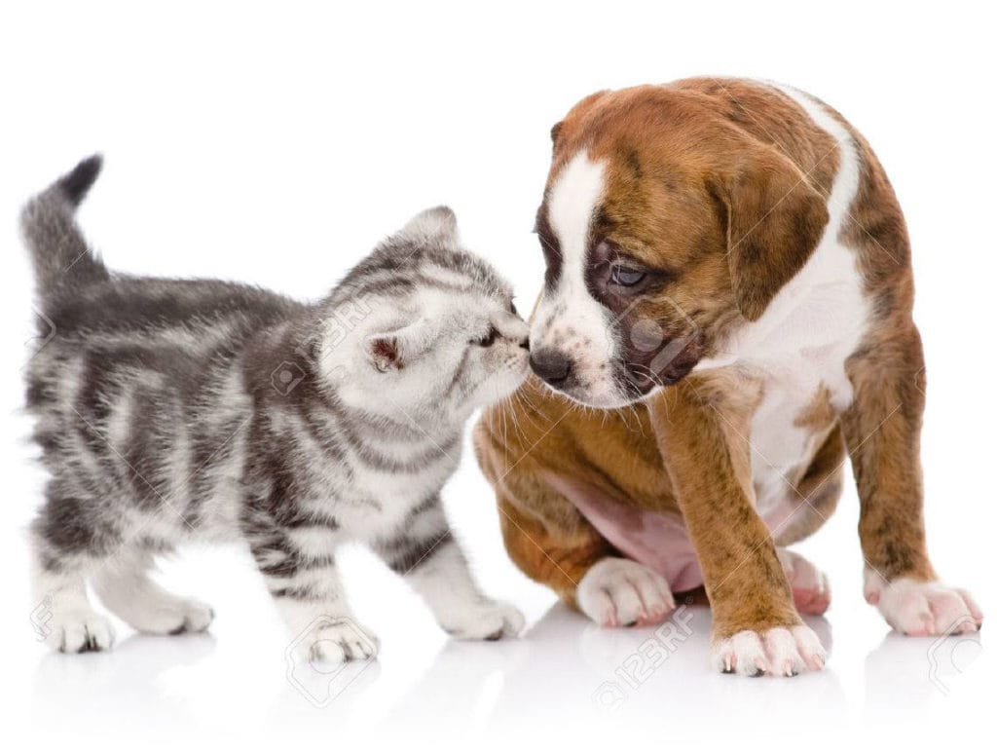
Pet Paradise
Group Member 7:
Aniket Shinde (TL) Vaishali Kele
(210910120027) (210910120036)
Rupesh Malik Twinkle Dhake
(210910120022) (210910120035)
Guide: Ms. Vishakha Kabasi

Slide 2
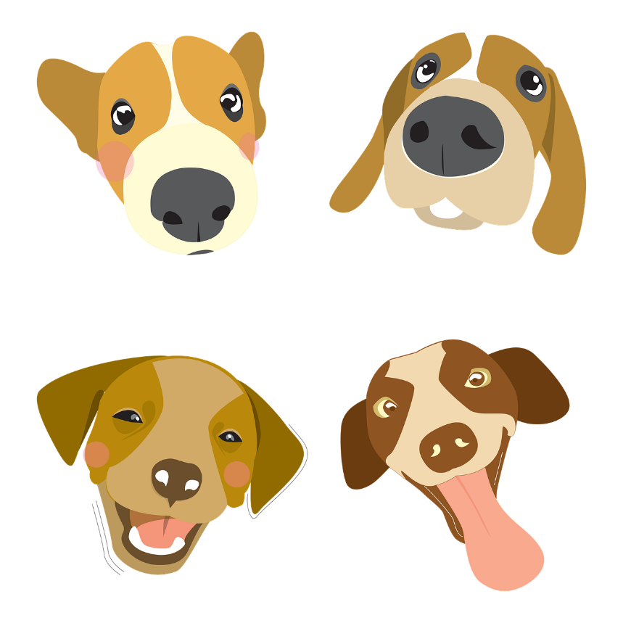
Content
Abstract
Introduction
Objectives
Problem Statement
Advantages Of Systems
Applications
Technologies Used
Use case Diagram
Entity Relationship Diagram
Future Scope
Conclusion

Slide 3
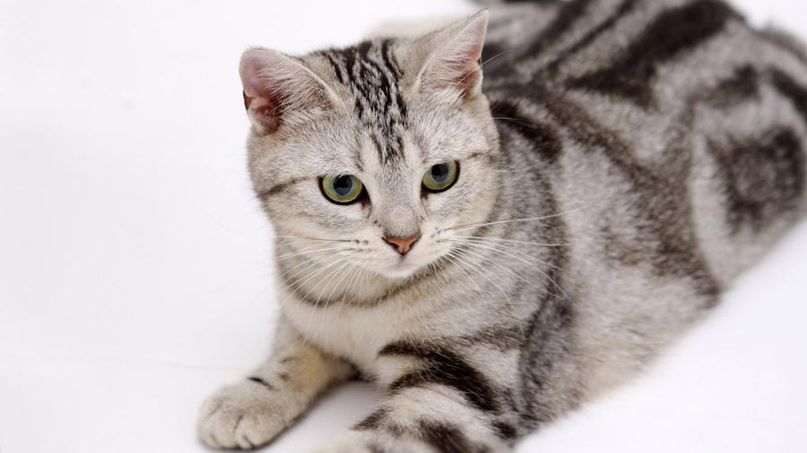
Problem Statement
With the growing society there are so many pets & abandoned Animals on the street and there is no online platform for Pet lovers to take care of them.
Like if an pet owners wants to sell their pets litters or put up them for adoption

Slide 4
Introduction
“An animal has not much mind than the human, but they have a loving heart and loyalty.”
Pet keeping is a common part of many cultures. Humans have been sharing their lives with animals from time immemorial. According to research, pets can have a profound effect on us. Interacting with a pet that behaves properly can have a positive effect on you and the people around you.

Slide 5
Introduction
we are designing a platform for all the animals and animal lover. One can buy and sell the pet online in trusted hand. For the homeless animals, we can click a picture and post our site and then nearby animal shelter will take care of those animals
. Animal Lovers can also share their feeling, opinion and advice. Doctor, trainer & petcaretakers contact & details have also been provided to take care of their pet.

Slide 6

Objectives
Providing a simple web application for Pet Lovers
Buy and Sell a pet or put up their pet for adoption
Can search Pet caretaker.
Can search pet Trainer .
Can search Animal shelter.
Make easy contact to Pet veterinary

Slide 7
Technologies Used:-
MySQL
SpringBoot, Hibernate
ReactJs

Slide 8

MySQL
MySQL, the most popular Open Source SQL database management system, is developed, distributed, and supported by Oracle Corporation.
Features of MySQL:
Software is Open Source.
Server works in client/server or embedded systems.
Database Server is very fast, reliable, scalable, and easy to use.

Slide 9
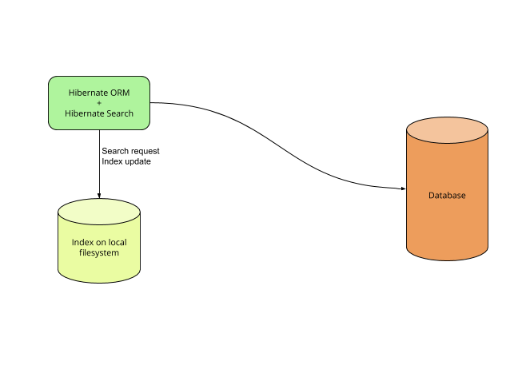
Features of MySQL:
Open Source and Lightweight
Fast Performance
Database Independent Query
Automatic Table Creation
Simplifies Complex Join

Slide 10
SPRINGBOOT
Spring Boot is an open source Java-based framework used to create a micro Service. It is developed by Pivotal Team and is used to build stand-alone and production ready spring applications.
Spring Boot provides a good platform for Java developers to develop a stand-alone and production-grade spring application that you can just run. You can get started with minimum configurations without the need for an entire Spring configuration setup.
In Spring Boot, everything is auto configured; no manual configurations are needed.
It offers annotation-based spring application

Slide 11

Hibernate
Hibernate is an object–relational mapping tool for the Java programming language.
It provides a framework for mapping an object-oriented domain model to a relational database.
Hibernate handles object–relational impedance mismatch problems by replacing direct, persistent database accesses with high-level object handling functions.

Slide 12
ReactJs
React (also known as React.js or ReactJS) is a free and open-source front-end JavaScript library for building user interfaces or UI components. It is maintained by Facebook and a community of individual developers and companies.
React can be used as a base in the development of single-page or mobile applications.

Slide 13
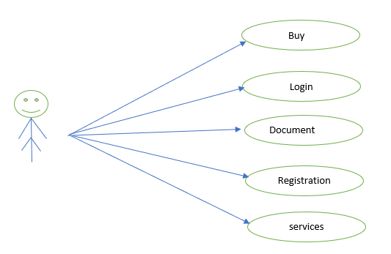
Use Case Diagram
Use Case flow Diagram (Buy):

Slide 14
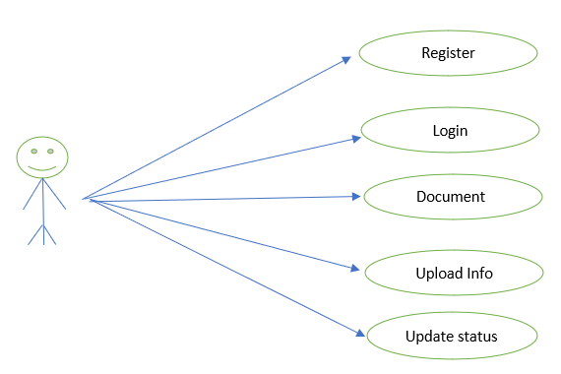
Use Case Diagram
Use Case flow Diagram (Seller):

Slide 15
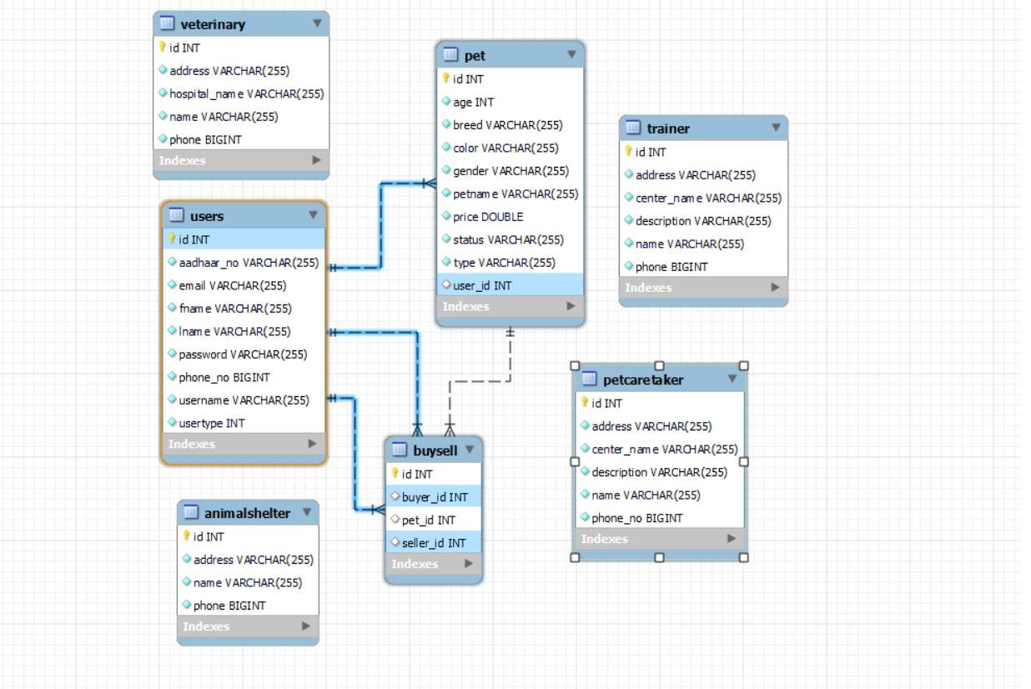
ER Details in Database using MySql

Slide 16
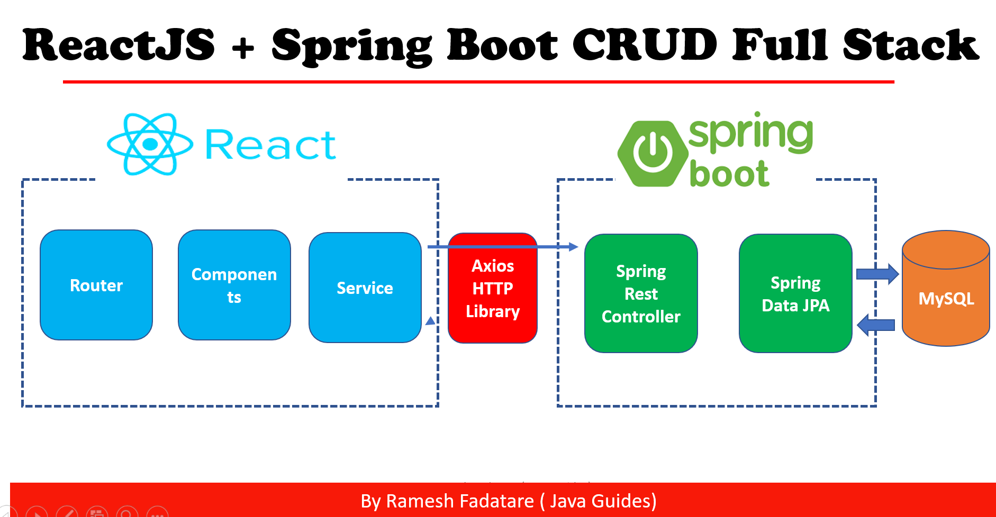
Project Architecture

Slide 17
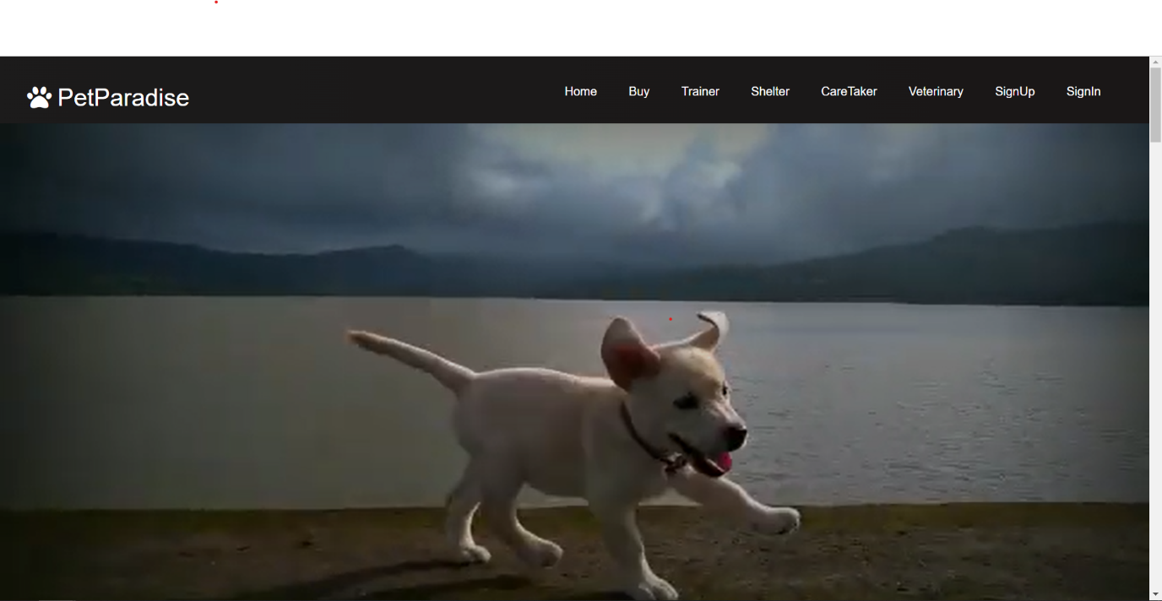
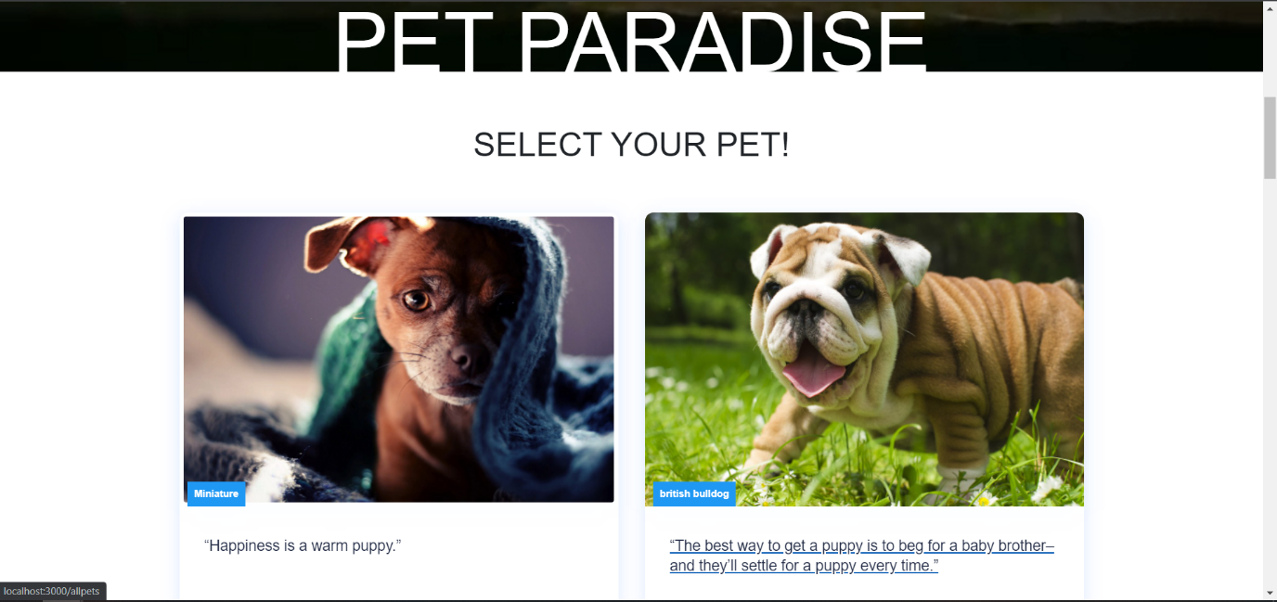
IMPLEMENTATION: Home page

Slide 18
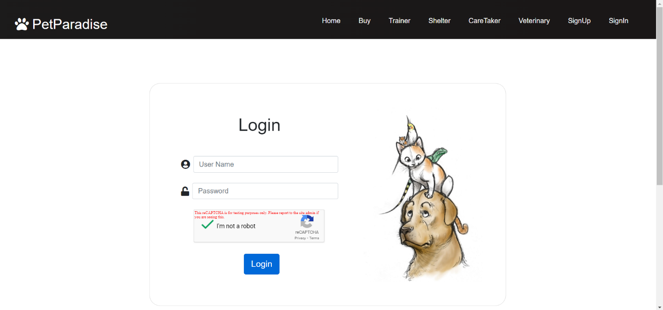
Login Page Interface:

Slide 19
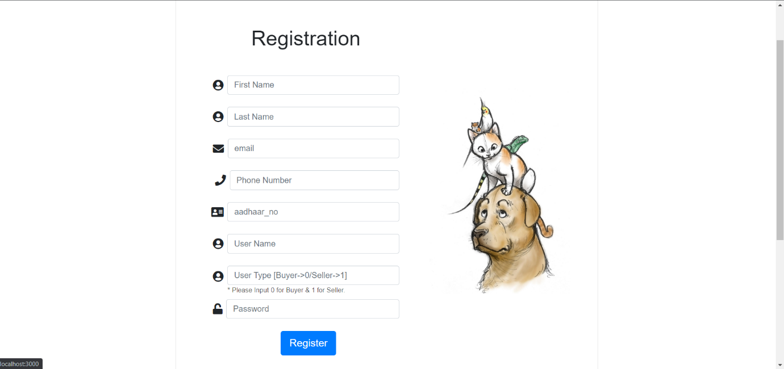
Registration Page Interface:

Slide 20
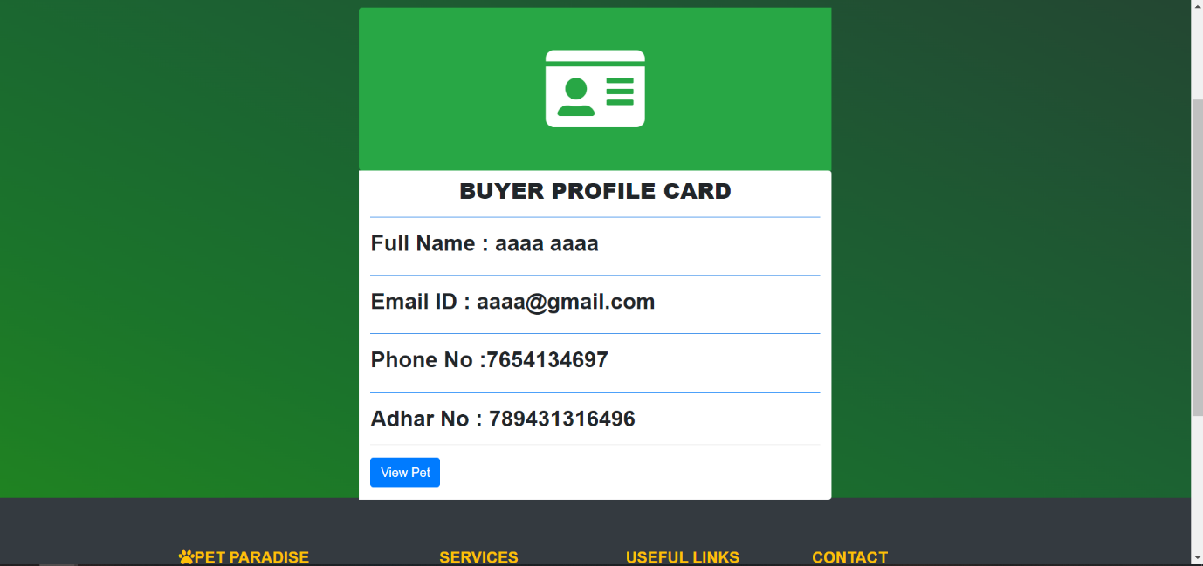
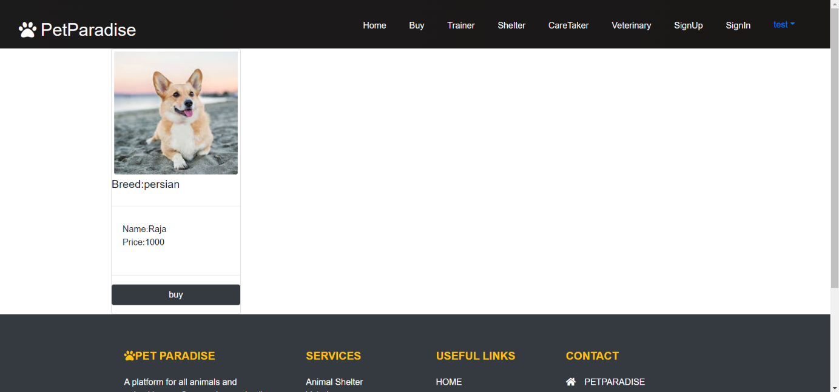
Buyer Profile Interface: Buyer Profile
Buyer Cart

Slide 21
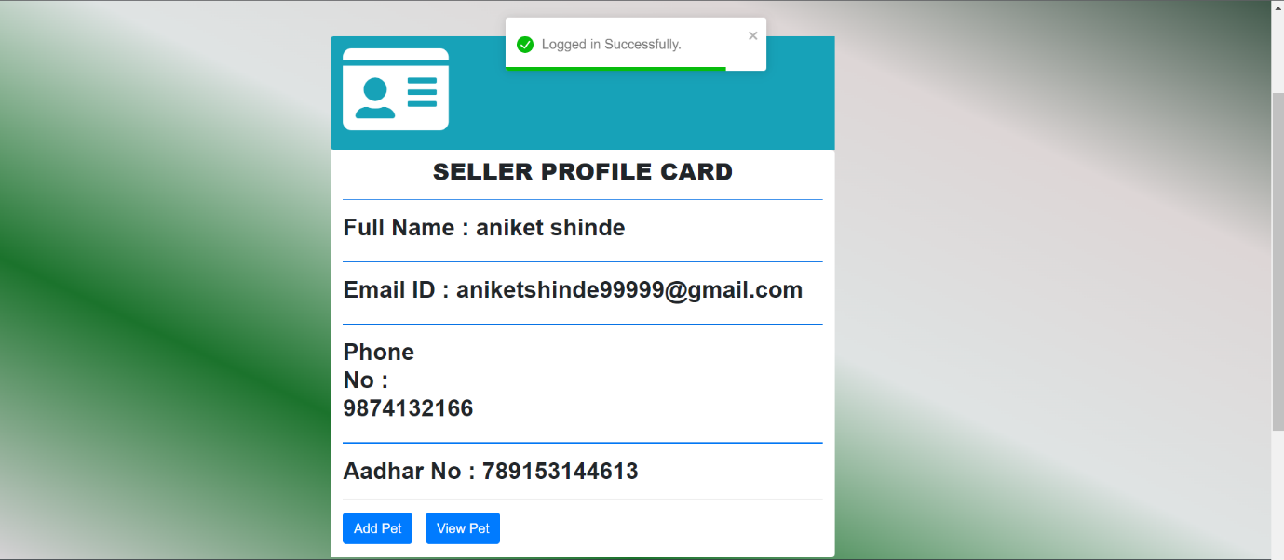
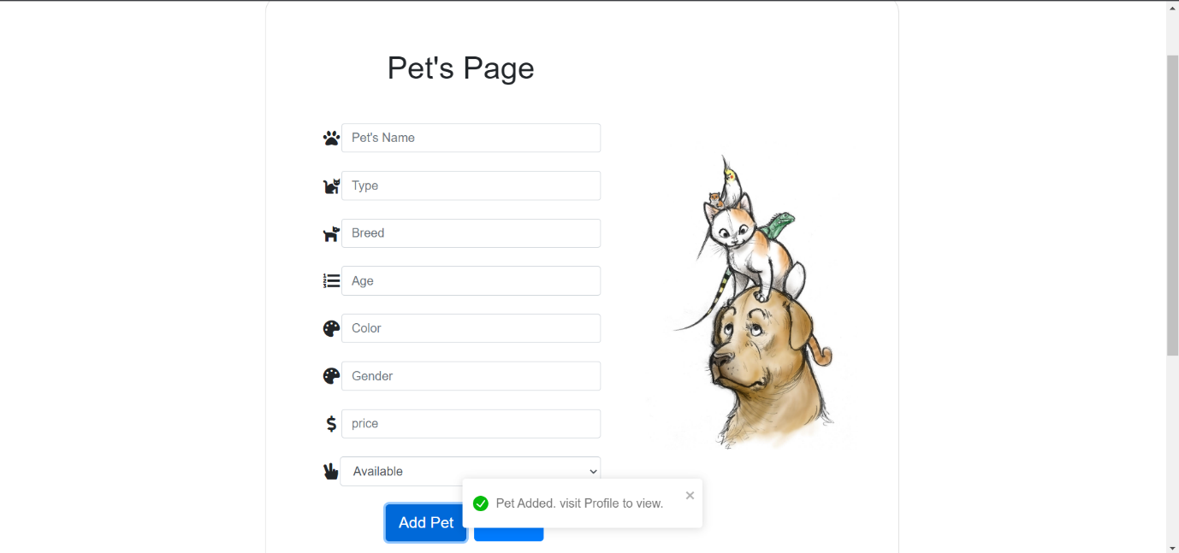
Seller Profile Interface: Seller Profile
Add Pet

Slide 22
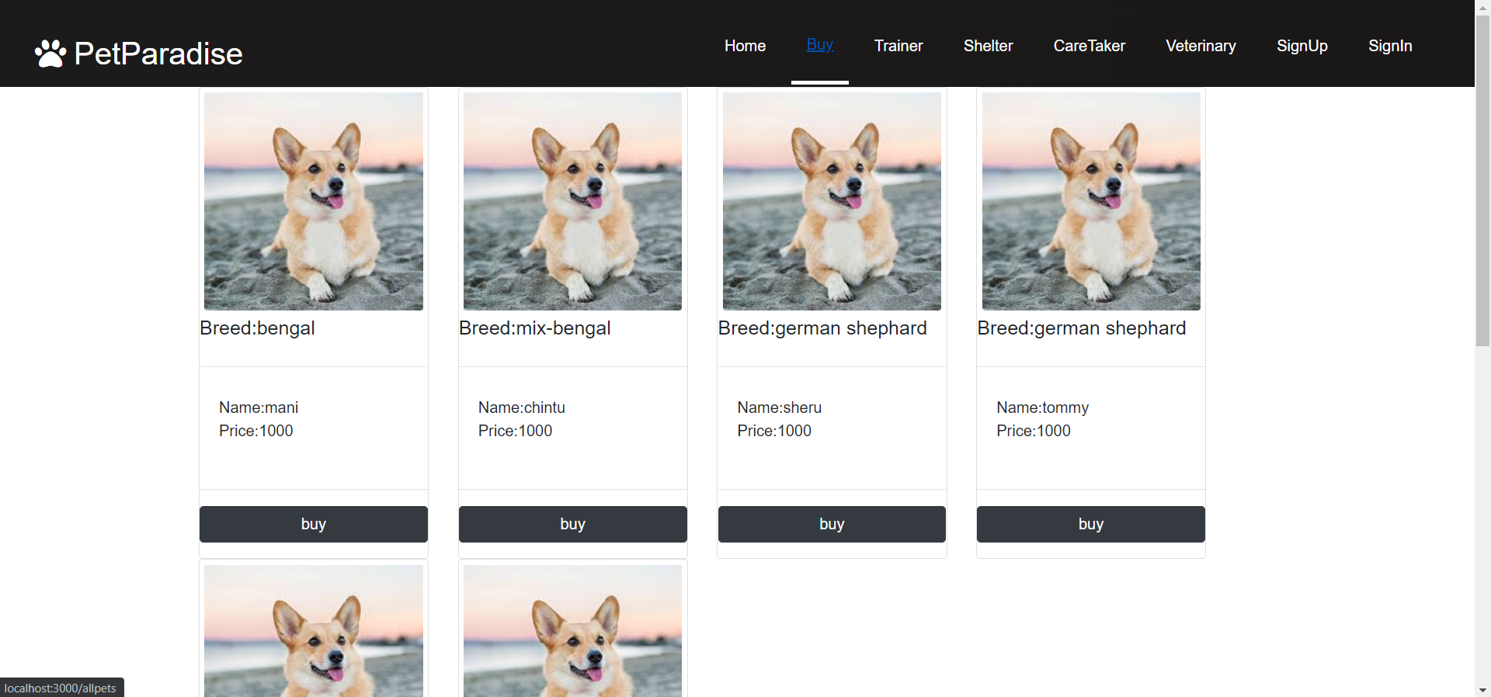
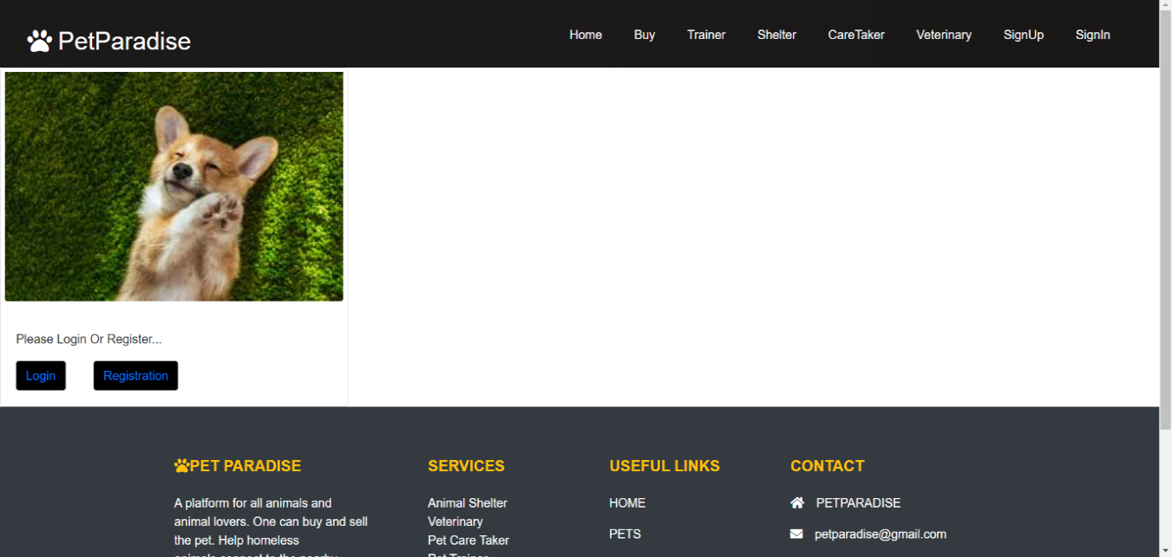
NAVBAR: Buy Interface:
If not logged in

Slide 23
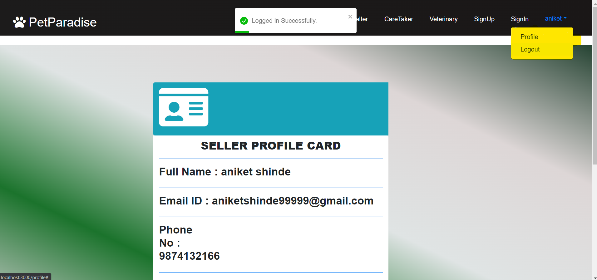
After clicking on buy

Slide 24
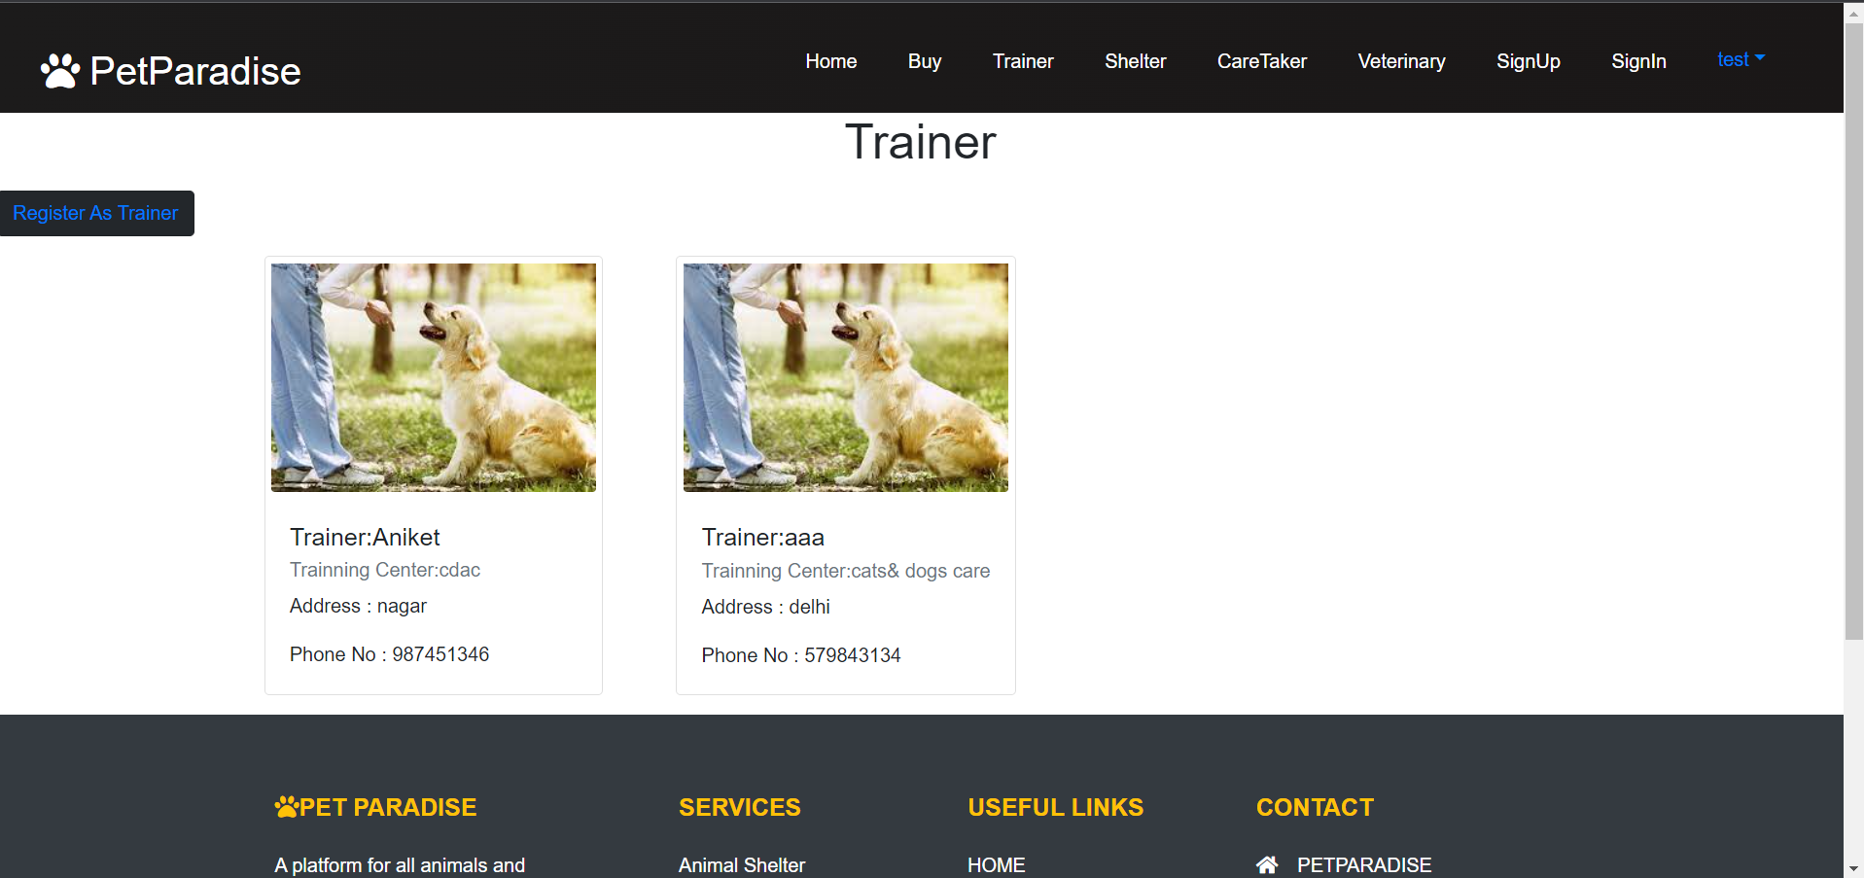
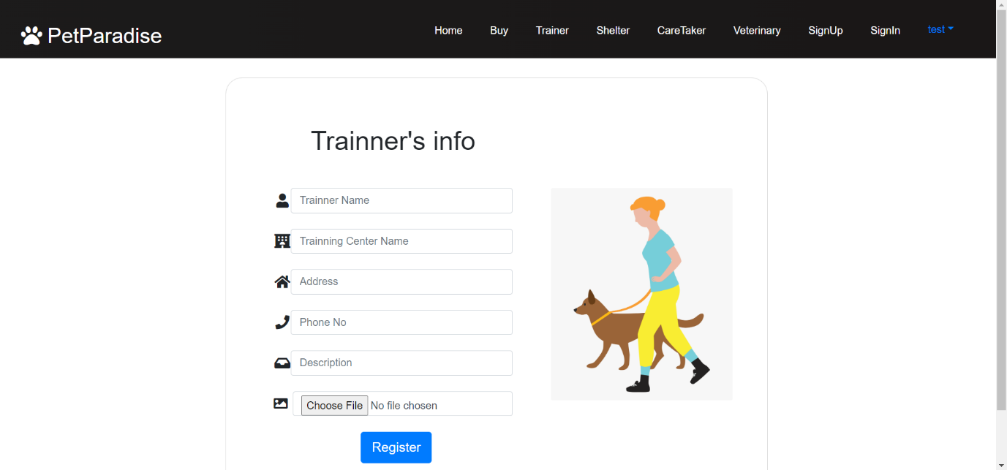
Trainer Interface:
Trainer Register:

Slide 25
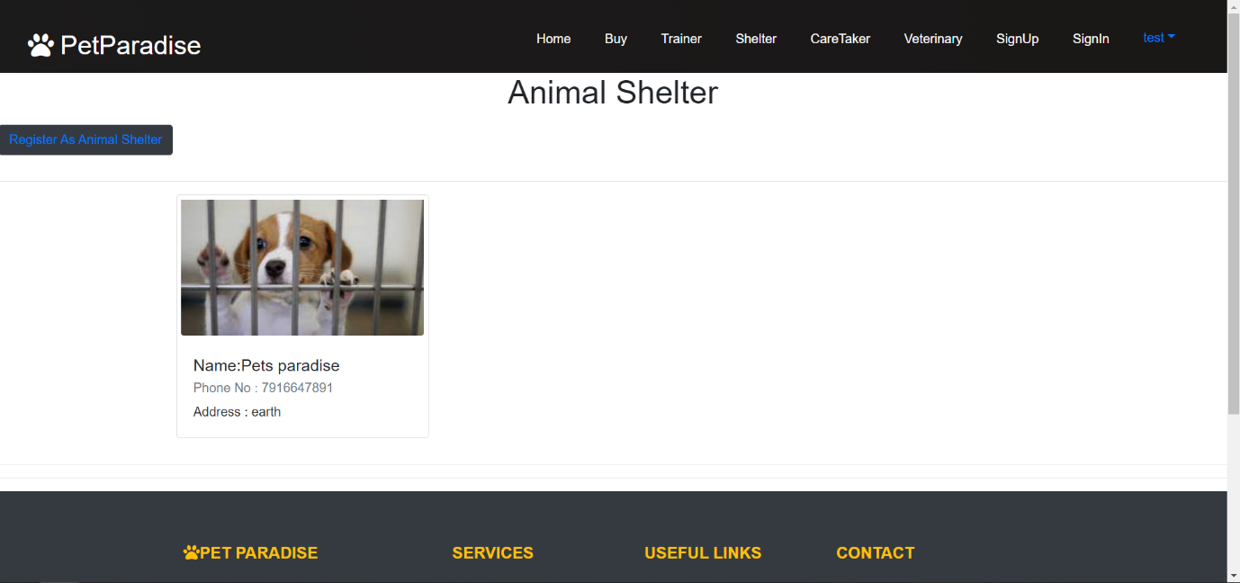
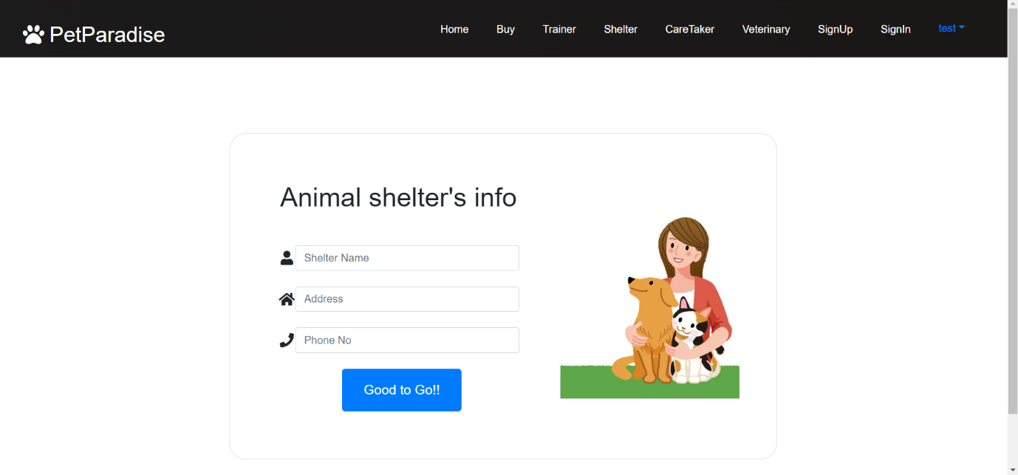
Animal Shelter Interface:
Animal Shelter Register:

Slide 26
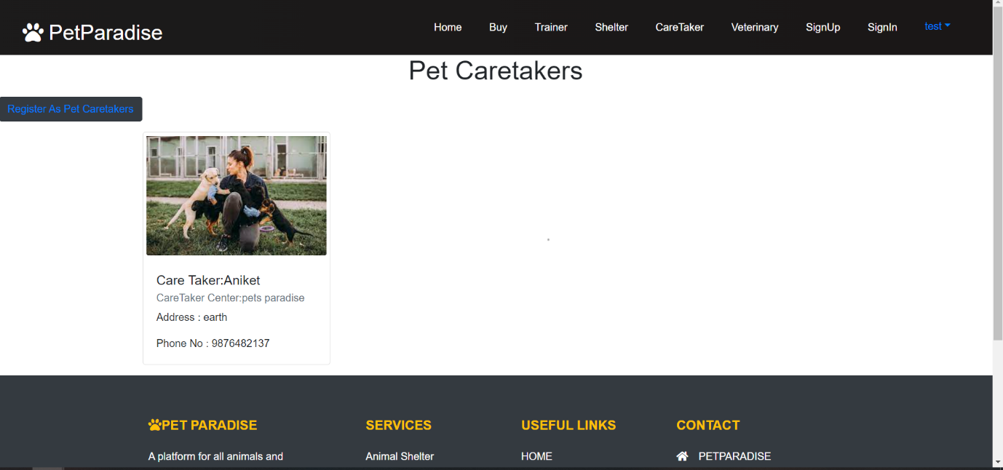
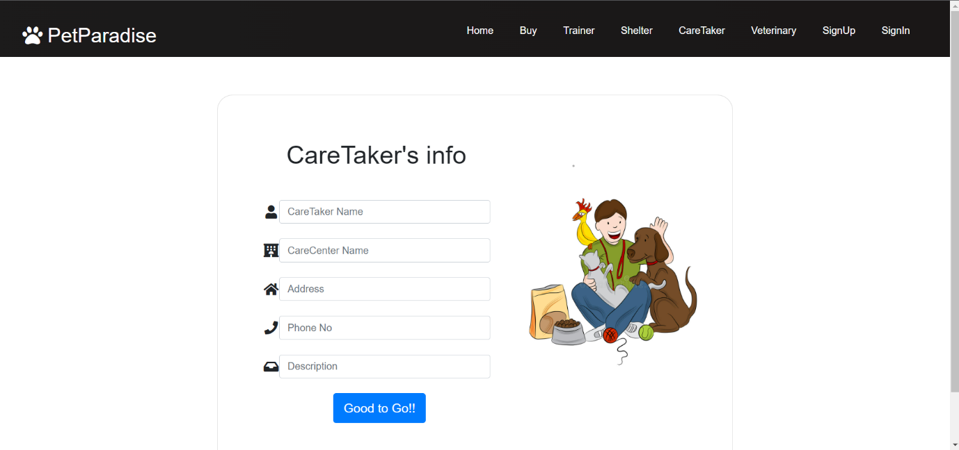
Pet Caretaker Interface:
Pet Caretaker Register:

Slide 27
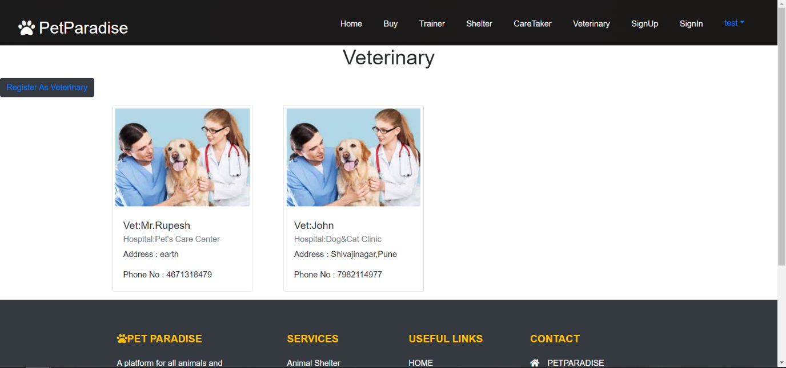
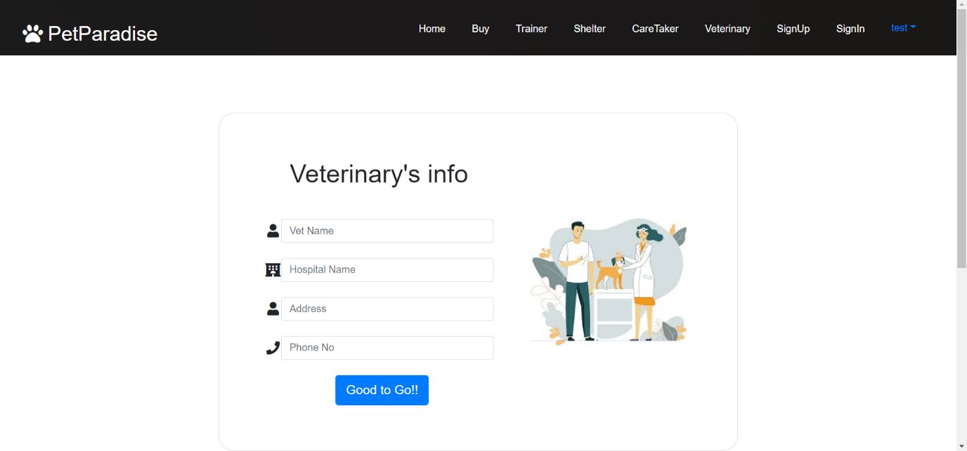
Veterinary Interface:
Veterinary Register:

Slide 28
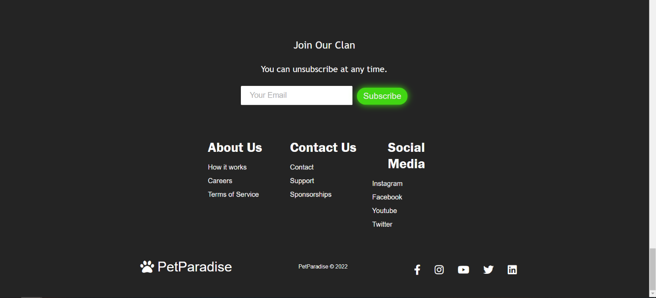
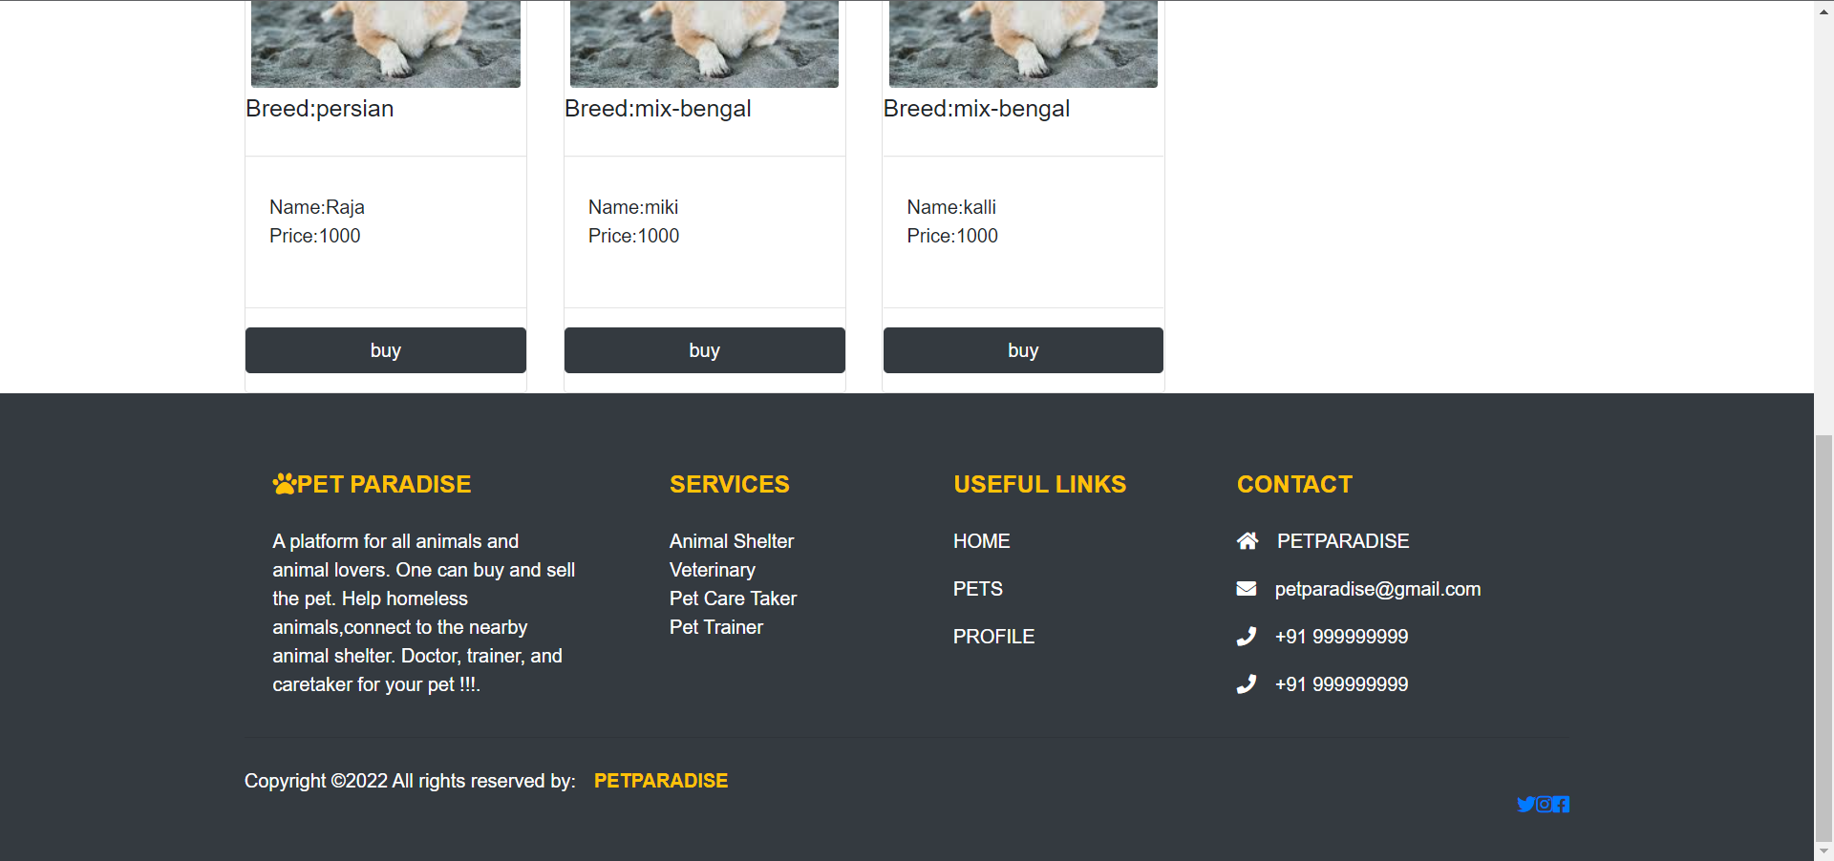
Footer Home page footer
Rest of the pages footer

Slide 29

Logout

Slide 30
Future Scope
Pet related stuff such as toys,food.
Vaccination appointments
Tracking feature
Payment gateway

Slide 31
Conclusion
As conclusion, the main objective of pet Paradise system has been achieved that is Buying and selling of the pets with services like shelter, veterinary, trainer & caretakers available in one single platform.
This platform helps in getting the contact details of animal shelter, pet caretakers, pet trainers, pet veterinary thus saving the valuable time and effort of pet lovers & providing the much needed help to the abandoned animal.

Slide 32
Thank You!

